Slide 1
Legal Texts in the Dictionary of Authorities (RAE, 1726 – 1739)

Slide 2
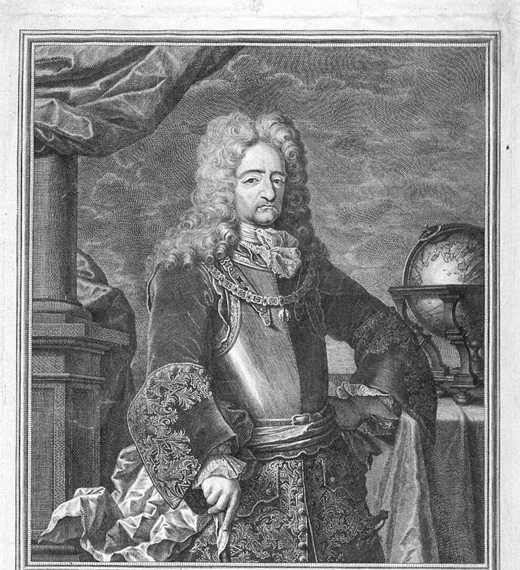
I have a dream…
“… to assure that Spanish speakers will always be able to read Cervantes."

Slide 3
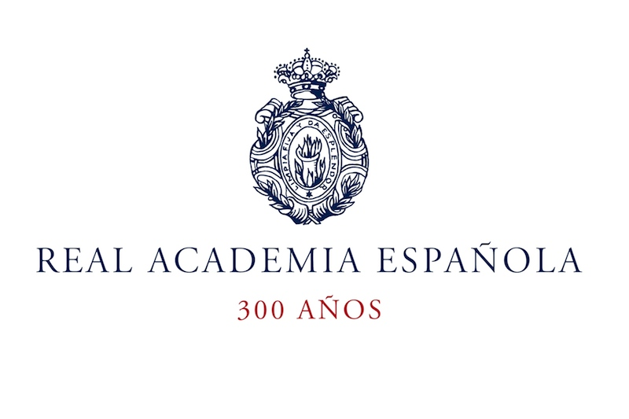
The Royal Spanish Academy (RAE):
“Cleans, sets, and cast splendour [sc. upon the Spanish language] ”

Slide 4
Editions of the Diccionario de la lengua española
Edition Year
1 1780
2 1783
3 1791
4 1803
5 1817
6 1822
7 1832
8 1837
9 1843
10 1852
11 1869
12 1884
Edition Year
13 1899
14 1914
15 1925
16 1936/1939
17 1947
18 1956
19 1970
20 1984
21 1992
22 2001
23 2014

Slide 5
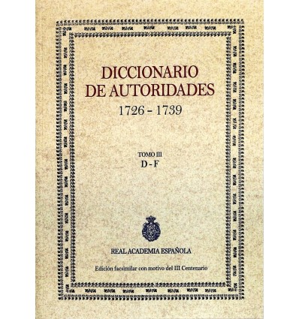
The Dictionary of Authorities 1726 - 1739

Slide 6
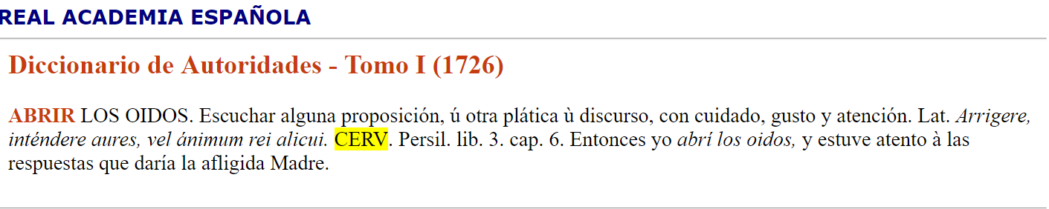
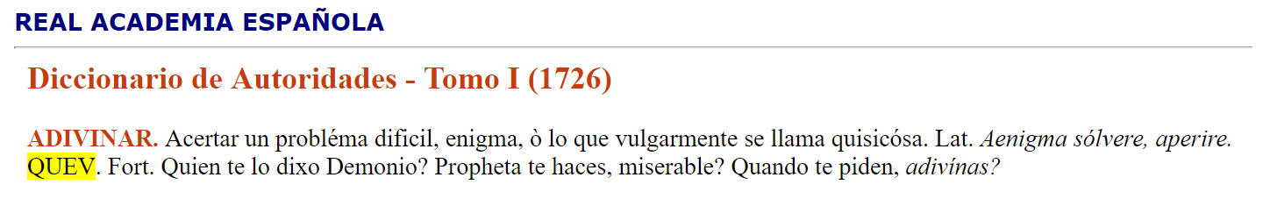
Quoting Miguel de Cervantes
Quoting Francisco de Quevedo

Slide 7
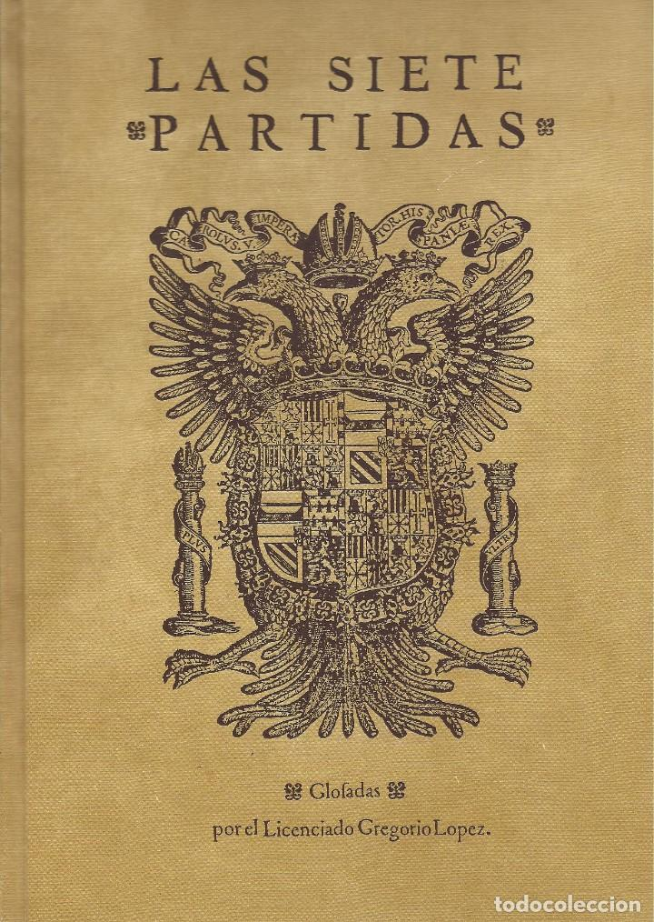
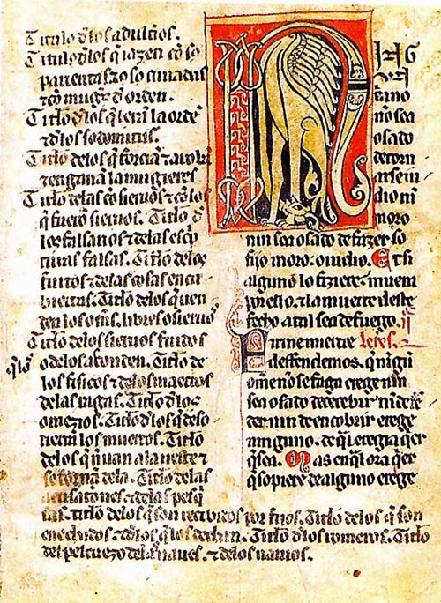
Juridical Documents Cited in the Dictionary
Las Siete Partidas
Fuero Real

Slide 8
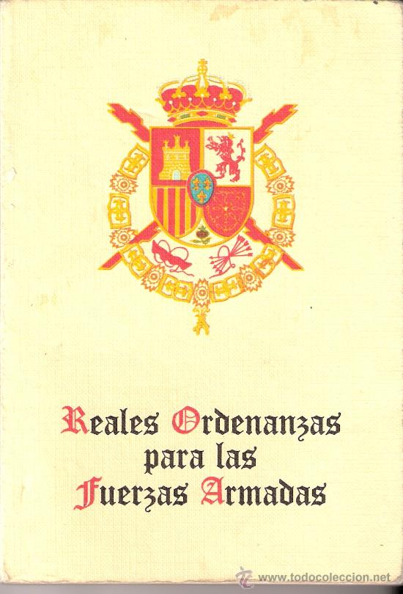
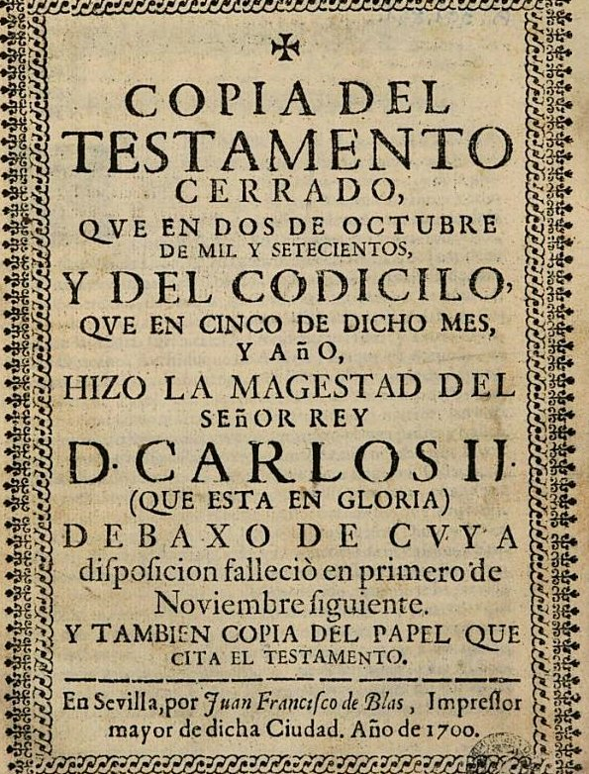
Juridical Documents Cited in the Dictionary
Ordenanzas Reales
Testamento del rey Carlos II

Slide 9
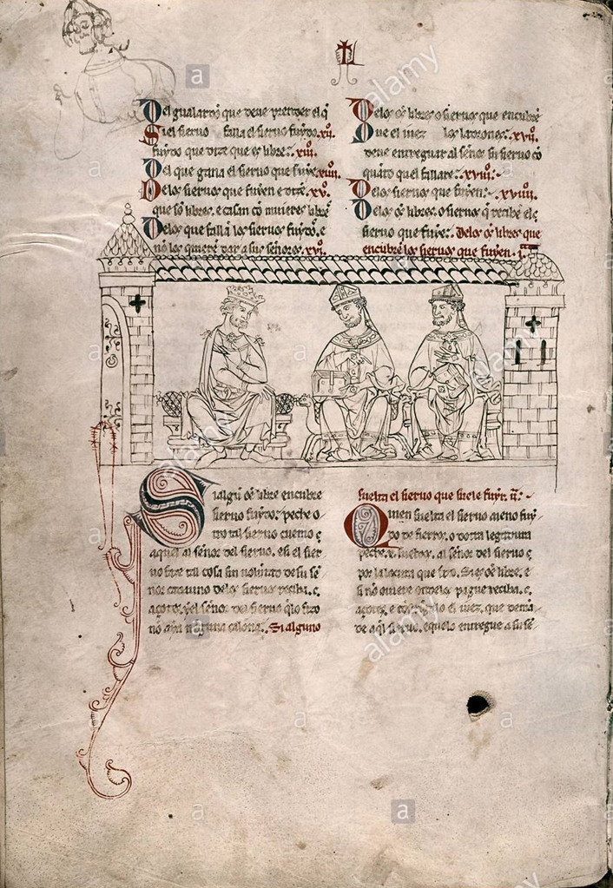
El Fuero Juzgo (1241)

Slide 10
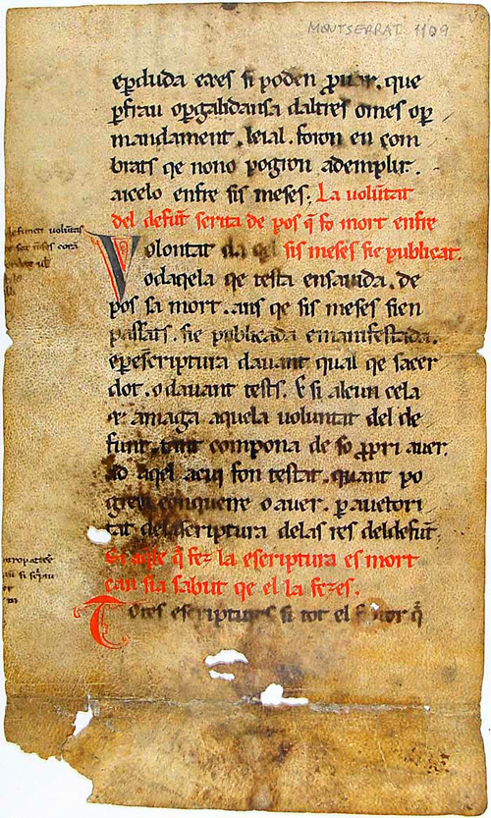
Liber Ludiciorum (654)

Slide 11
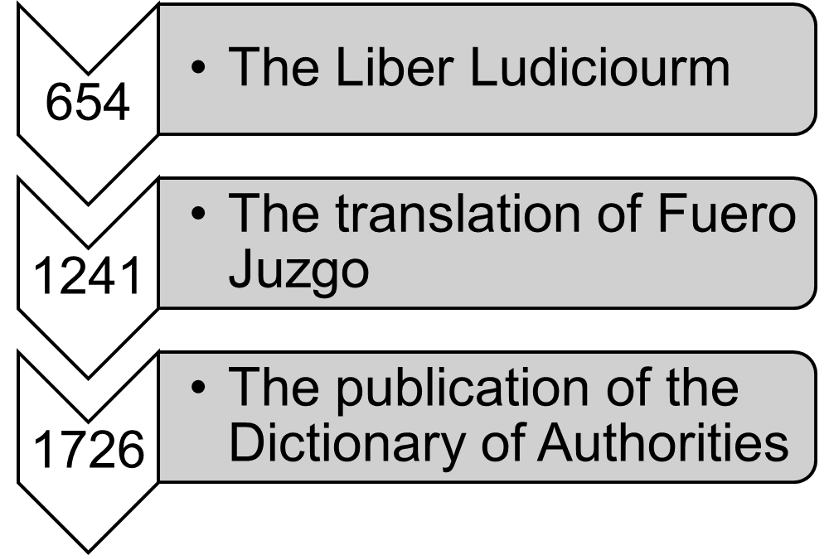

Slide 12
The legal terminology in the 18th century;
The legal terminology in the 13th century;
Concepts existing in the 7th century.

Slide 13
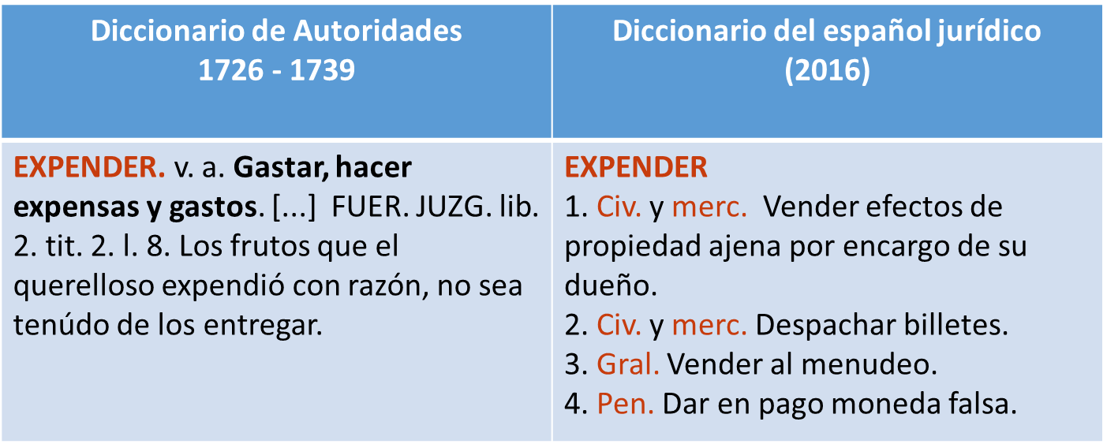

Slide 14
Time’s Up!
About your speaker:
  Name: Marija Žarković
  Institution: Universidade de Santiago de Compostela
  Social Media: LinkedIn, Facebook
  Quick bio:
  Born in Serbia
  Faculty of Philology, University of Belgrade
  EMLex Student (USC, UdL, UM)
  Internships: Universidad Autonoma de Barcelona, BBAW (DWDS)

